Slide 1
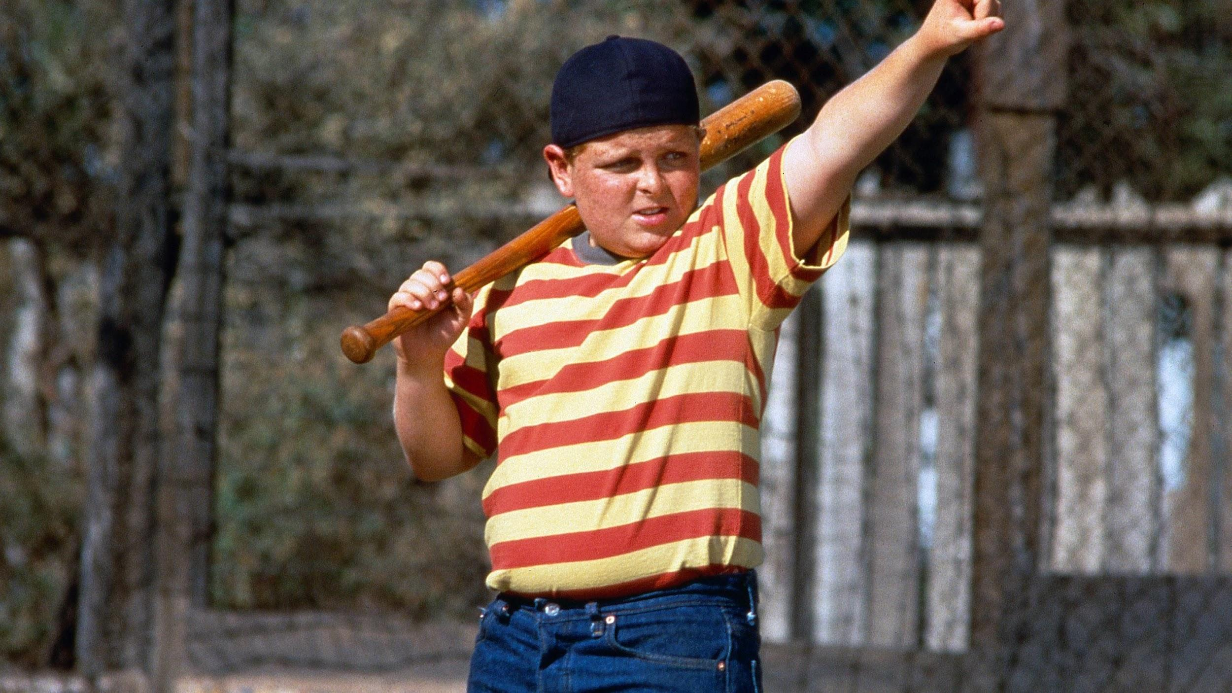
You’re killing me Smalls!
Project 3: Team 5
Troy Draizen
Evinski Benjamin
Junwei Luo
Lucas Gowland

Slide 2
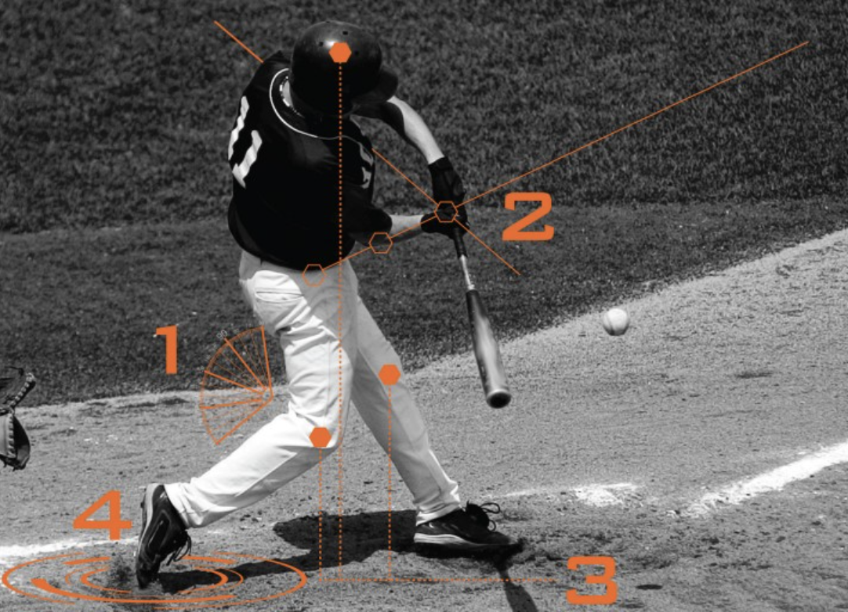
Abstract
We seek to gain greater insight into the body mechanics a baseball player uses to optimize power and efficiency in their swing.
Through a proprietary object detection AI, coupled with a deep learning neural network, we have been able to make great strides in defining what constitutes the optimal batting efficiency.
Once the optimal swing is identified, can we use this algorithm to detect amateur players potential before being drafting into the MLB?

Slide 3
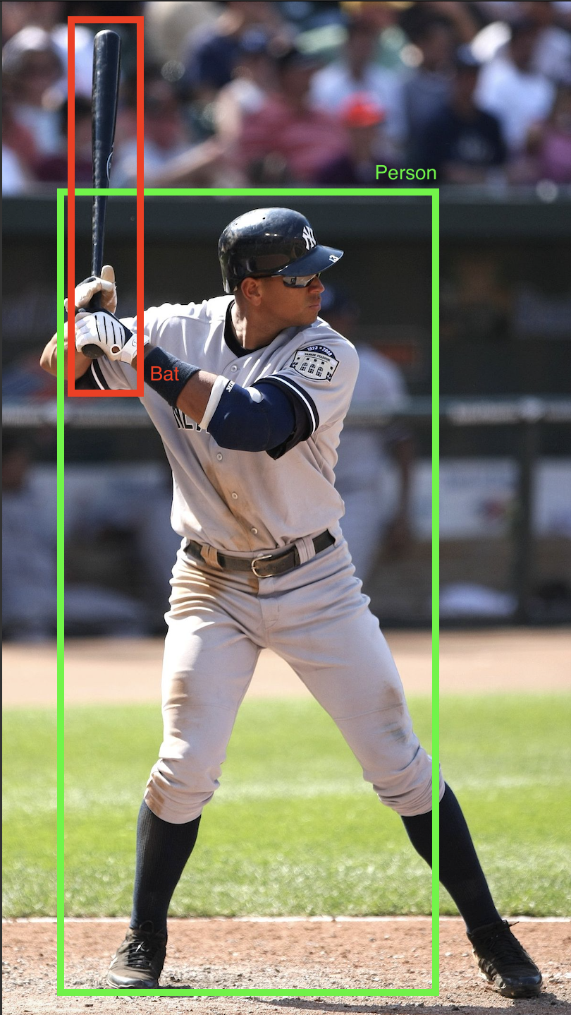
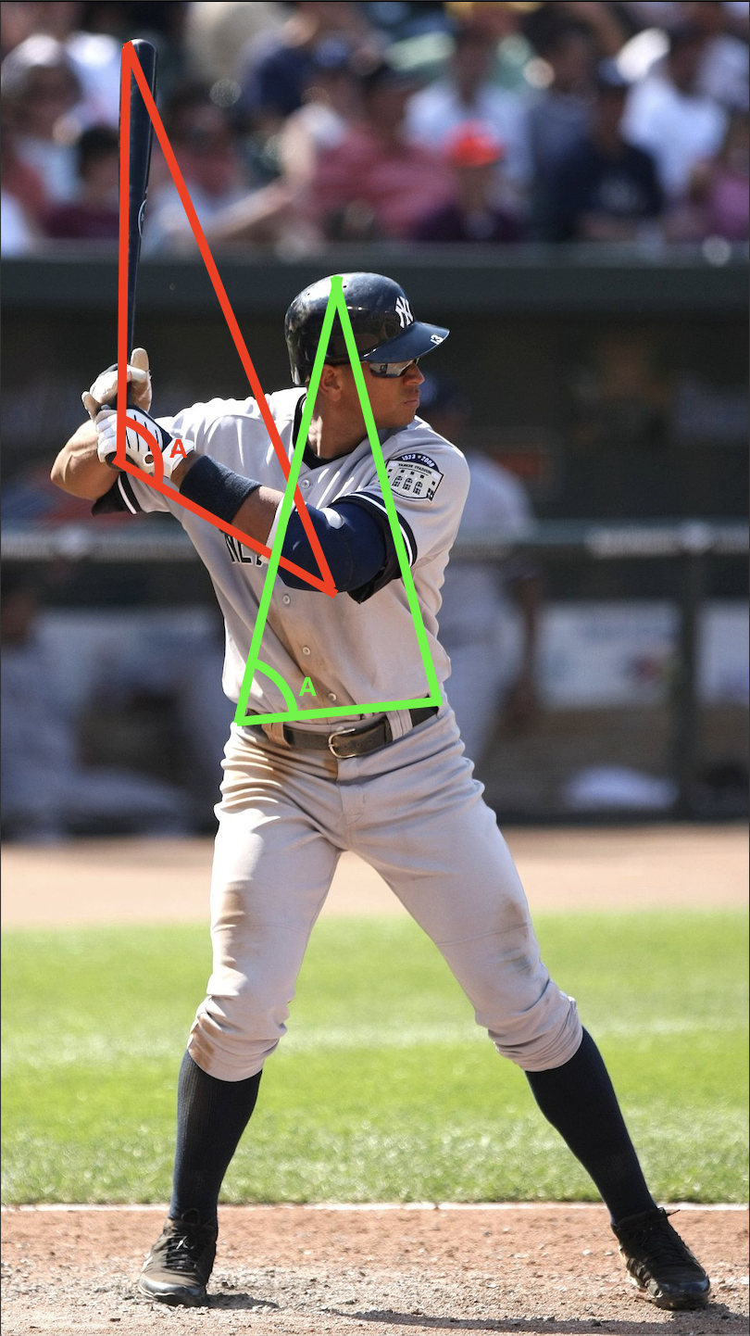
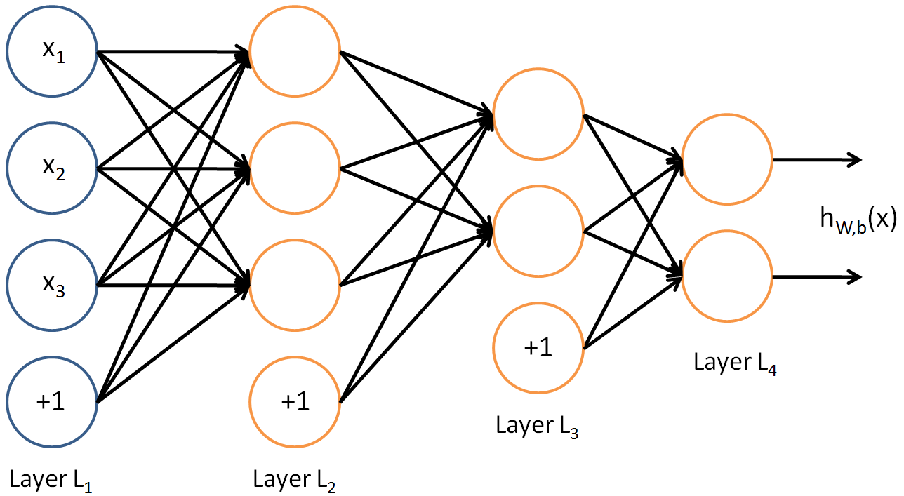
Model Summary = Multi-output classification
Tier Class
Batting Avg
Tier Class = Top / Middle / Bottom (Universe of top 1000 batting average of all time)

Slide 4
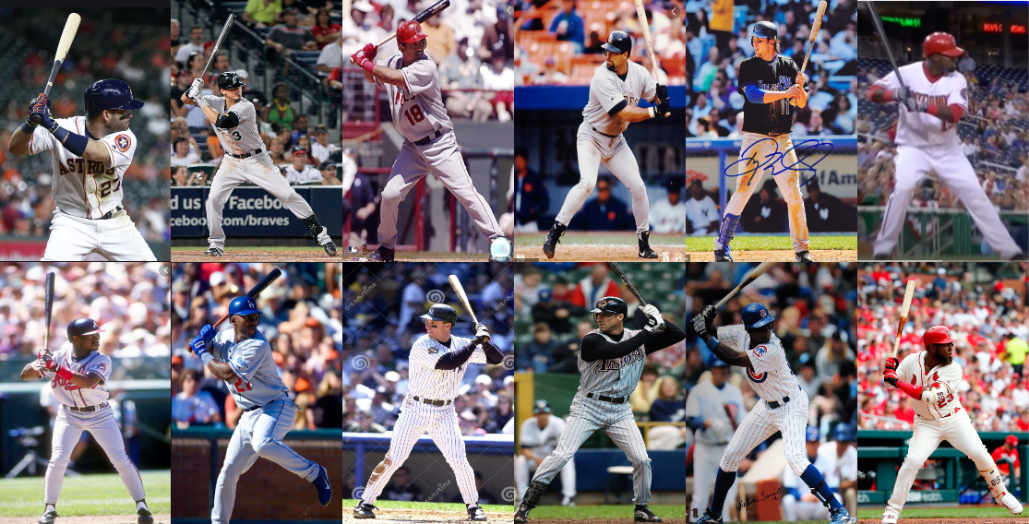
The Numbers of Best 1000 Batting Average
Average At Bats ~ 500 per Season
Difference Between Top 50 of all time and Bottom 50 is about 1.2 hits / week

Slide 5

LIbraries and Coding Used For Project
Math - Calculate Angles
NumPy - Used with Pandas for model interpretation / arrays
Scikit learn - Train / Test Splitting
PyCharm - Image processing with python
Keras/Tensorflow - Neural Network
LabelIMG - YOLO coordinates for angle dissemination CNN
Cvlib - open source / object detection and manipulation

Slide 6
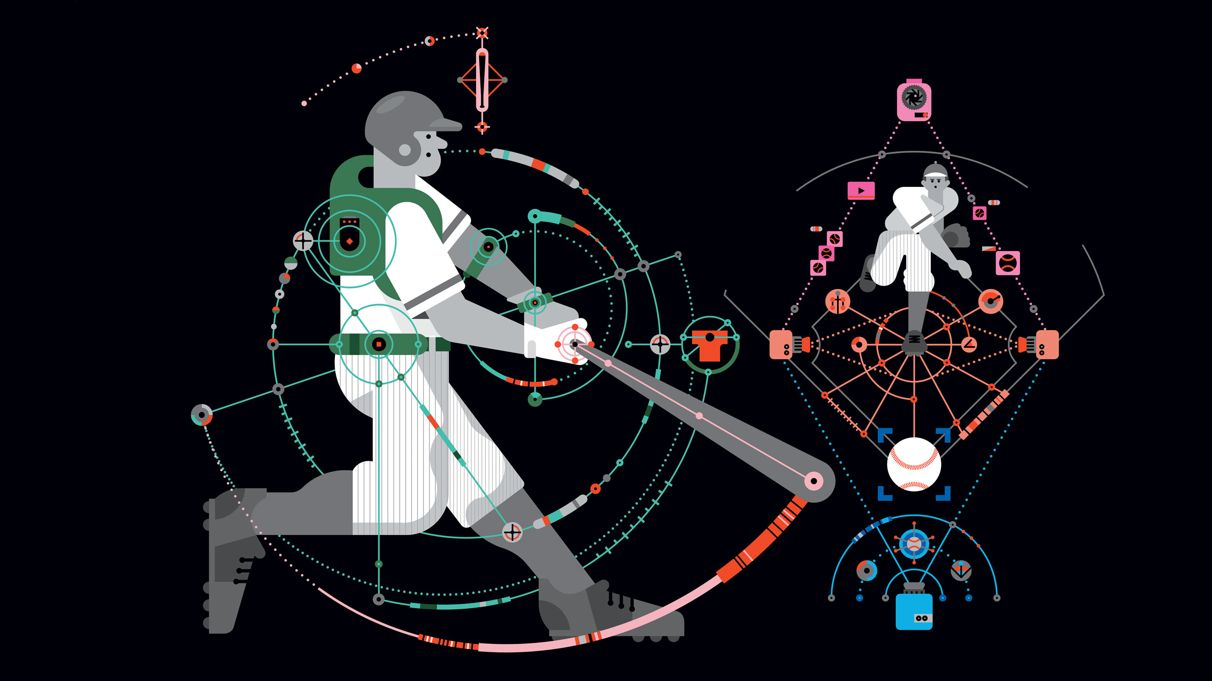
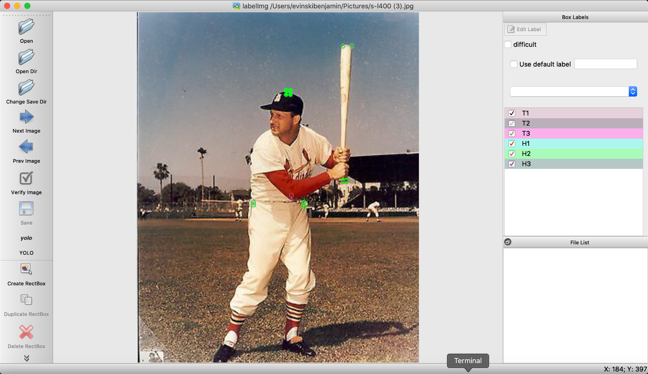
Data Cleanup & Model Training
Data Cleanup/ Model Training:
MLB historic data
Formatting data from left hand batter to right hand batter
Yolo format
Human level vs Basis Level
Data Cleanup/Model Training Challenges:
Data volume,availability and.consistency.
Image selection process.
Data standardization/reconciliation.
Data integration.
Data reliability,representation and bias.
Feature Selection. Avoid GIGO (Garbage in Garbage out)
Avoiding Under or Over fitting.

Slide 7
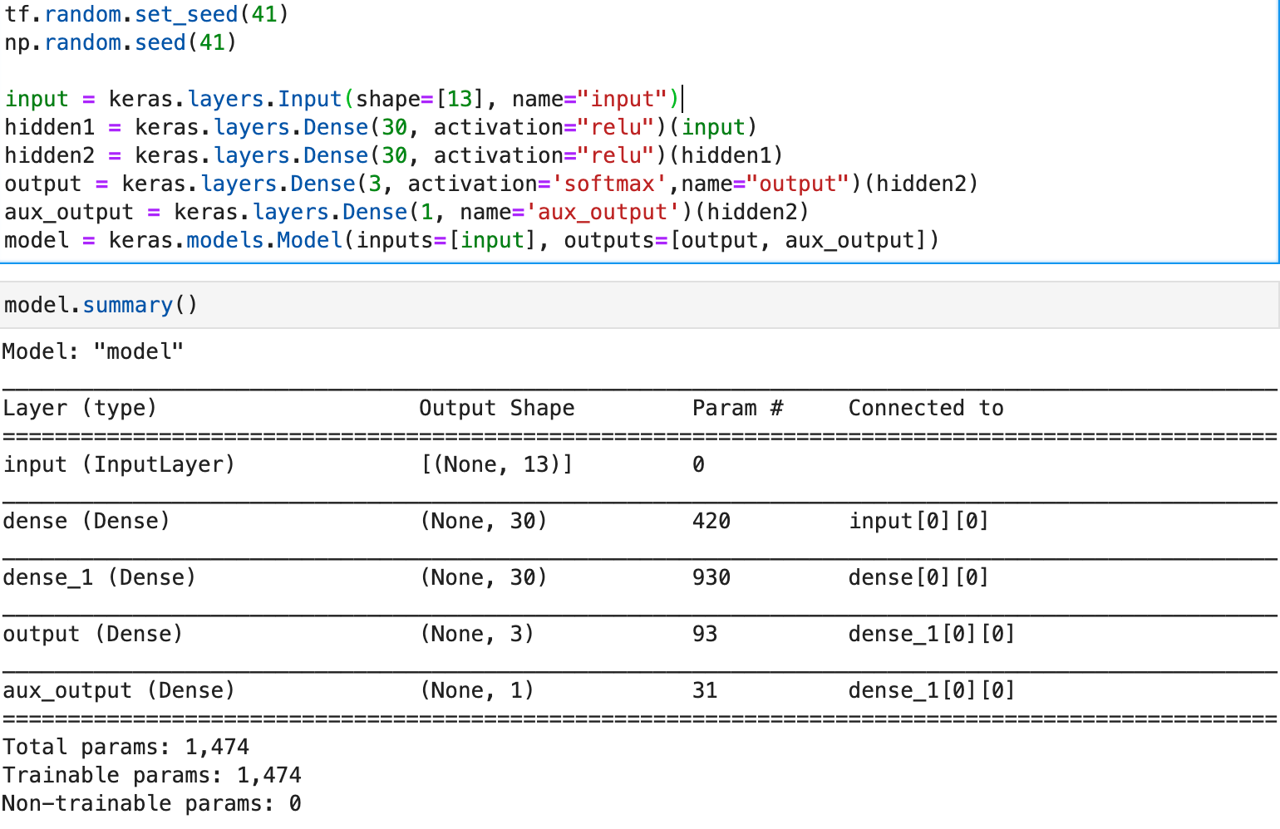
Model Evaluation
Conclusion:
Classifier accuracy 67% vs. naive prediction 33%
No obvious overfitting
Multi-output model helps accuracy
Small amount of training data

Slide 8
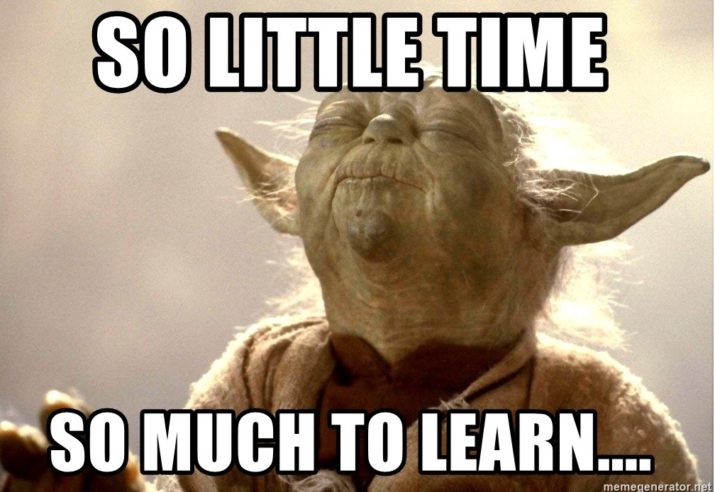
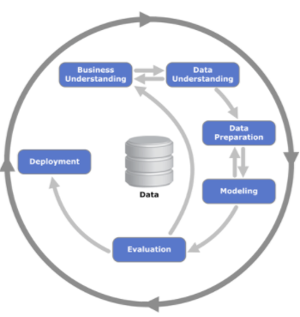
Postmortem
Next steps:
Potentially More Features (Hotbeds).
More Players.
Additional Angles
Video Optimization - Live angle calculation throughout the entire at bat
Pitch Counts
Environment
Location
Etc….
Most Difficult Part = Teaching Junwei baseball!

